Slide 1

CSA0888-PYTHON PROGRAMMING FOR NATURAL LANGUAGE PROCESSING
Capstone Project
Slithering Adventures: A Graphical User Interface (GUI) Snake Game
By
Aravinth Raj [192210197]
Praison Sam Asirvatham[192210260]

Slide 2

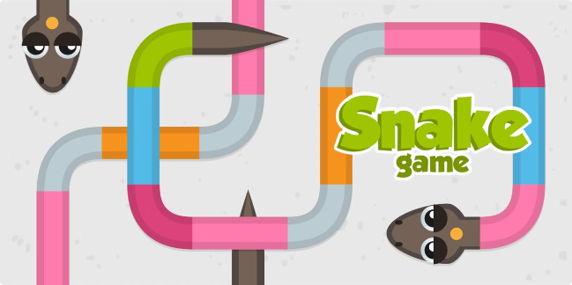
Slithering Adventures: A Graphical User Interface (GUI) Snake Game
This project delves into the development of a visually engaging and interactive GUI-based Snake game. It aims to enhance the classic gameplay with modern design elements and intuitive controls.

Slide 3
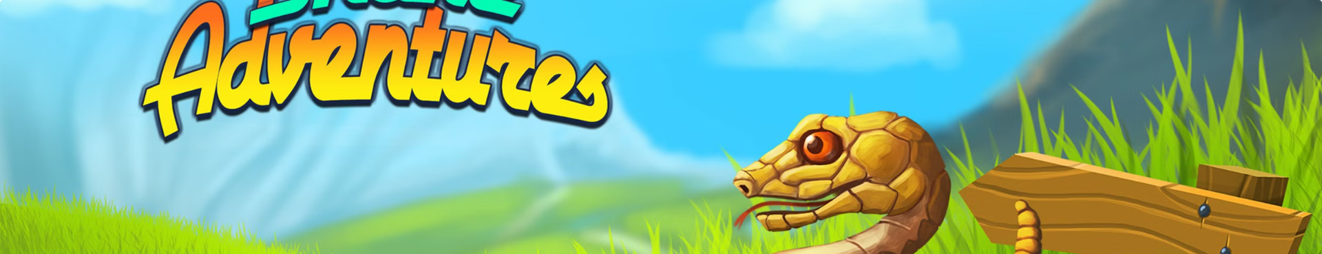
Objective
1
Interactive Gameplay
2
User-Friendly Interface
To create a captivating and engaging Snake game experience for users.
To design a simple and intuitive GUI that enhances user interaction.
3
Modern Design
4
Performance Optimization
To incorporate contemporary visual elements and animations for enhanced aesthetics.
To ensure smooth gameplay and efficient resource utilization.

Slide 4

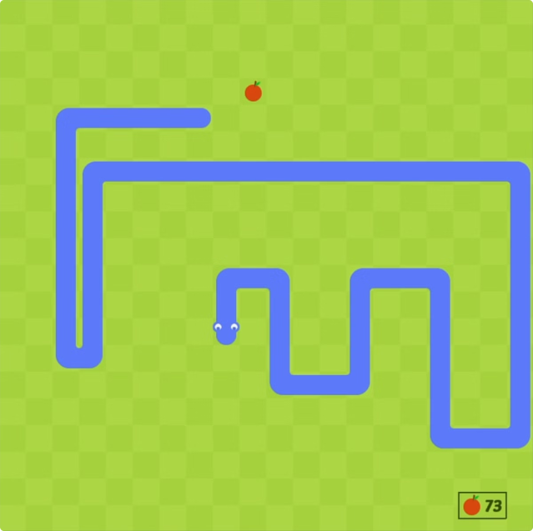
Abstract
Classic Gameplay
Combines classic gameplay with modern design principles
Visual Appeal
Aims to provide a visually appealing experience
User-Friendly
Focuses on a user-friendly experience

Slide 5
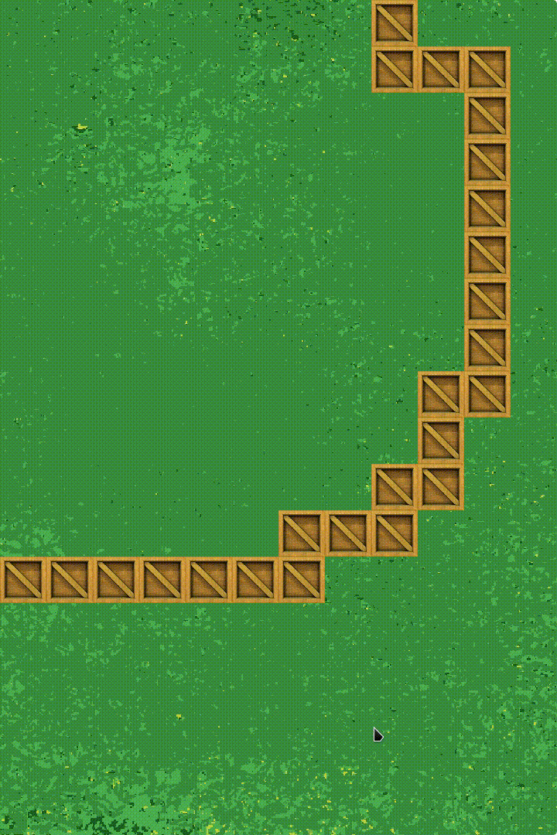
Advantages of the Proposed System
The proposed system offers a visually engaging and interactive interface.
Utilizing modern programming techniques ensures smooth gameplay and efficient resource utilization.
The game incorporates contemporary design elements, creating a visually appealing experience.

Slide 6
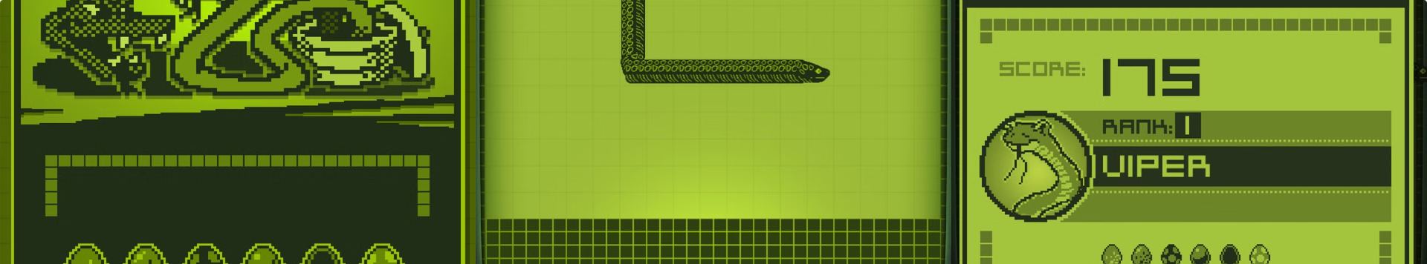
Disadvantages of the Existing System
Lack of Modern Aesthetics
Limited Functionality
Poor Optimization
Furthermore, the limited functionality and customization options in existing Snake games can make the gameplay feel repetitive and lacking in replay value.
Additionally, poor optimization can result in performance issues and a less smooth gameplay experience.
Existing Snake games often lack modern aesthetics, intuitive controls, and efficient resource utilization, leading to a less engaging and visually appealing experience.

Slide 7

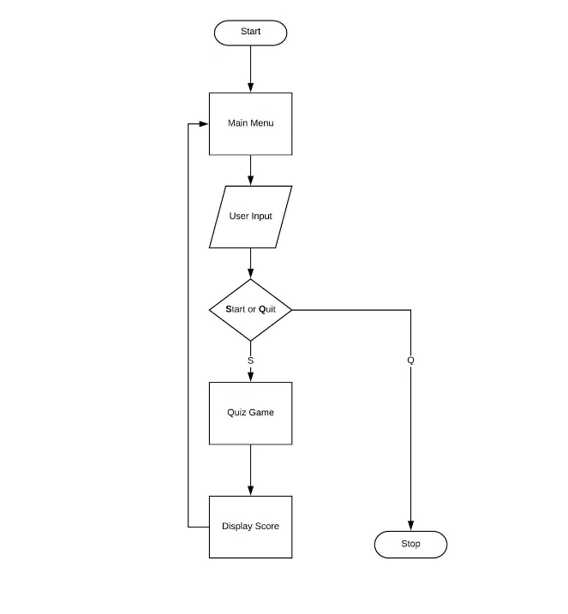
Methodology
1
Testing and Refinement
2
Basic Snake Game
This code implements a basic Snake game using Pygame.
3
Game Mechanics
The snake moves around the screen, controlled by arrow keys, to eat randomly placed food, growing in length with each piece eaten.
4
End Game Conditions
The game ends if the snake collides with the screen edges or itself, displaying a "You Lost!" message with options to quit or restart.
5
Game Speed
The game's speed is controlled by the clock, with the display updated at a set interval to animate the snake's movement.

Slide 8

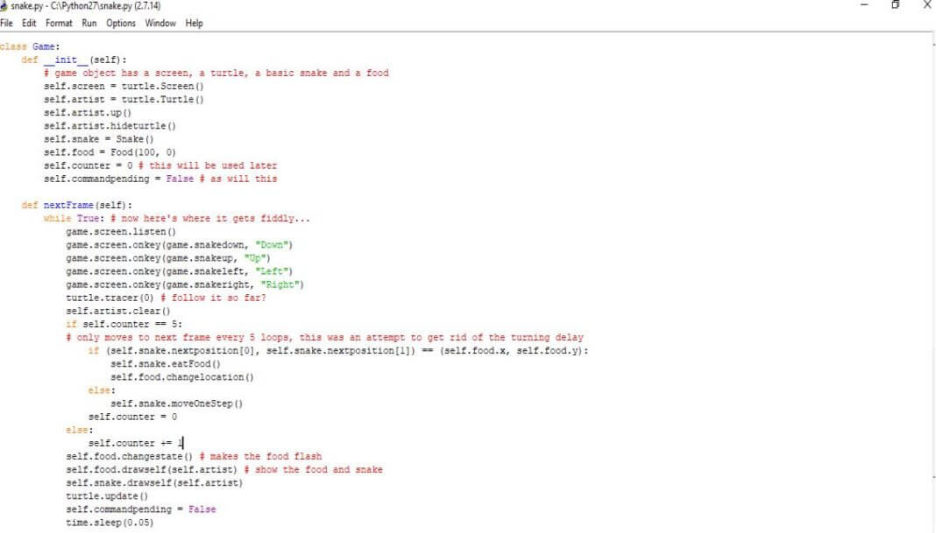
Implementation
Programming Language
The game was developed using a suitable programming language such as Python
Graphical Library
Along with a graphical library like Pygame
Interactive Games
This approach provides a powerful and versatile platform for developing interactive games with engaging visuals

Slide 9
Code:
import pygame
import time
import random
pygame.init()
white = (255, 255, 255)
yellow = (255, 255, 102)
black = (0, 0, 0)
red = (213, 50, 80)
green = (0, 255, 0)
blue = (50, 153, 213)
dis_width = 800
dis_height = 600
dis = pygame.display.set_mode((dis_width, dis_height))
pygame.display.set_caption('Snake Game')
clock = pygame.time.Clock()
snake_block = 10
snake_speed = 15
font_style = pygame.font.SysFont(None, 50)
score_font = pygame.font.SysFont(None, 35)
def our_snake(snake_block, snake_list):
for x in snake_list:
pygame.draw.rect(dis, black, [x[0], x[1], snake_block, snake_block])
def message(msg, color):
mesg = font_style.render(msg, True, color)
dis.blit(mesg, [dis_width / 6, dis_height / 3])
def gameLoop():
game_over = False
game_close = False
x1 = dis_width / 2
y1 = dis_height / 2
x1_change = 0
y1_change = 0
snake_List = []
Length_of_snake = 1
foodx = round(random.randrange(0, dis_width - snake_block) / 10.0) * 10.0
foody = round(random.randrange(0, dis_height - snake_block) / 10.0) * 10.0
while not game_over:
while game_close == True:
dis.fill(blue)
message("You Lost! Press Q-Quit or C-Play Again", red)
pygame.display.update()
for event in pygame.event.get():
if event.type == pygame.KEYDOWN:
if event.key == pygame.K_q:
game_over = True
game_close = False
if event.key == pygame.K_c:
gameLoop()
for event in pygame.event.get():
if event.type == pygame.QUIT:
game_over = True
if event.type == pygame.KEYDOWN:
if event.key == pygame.K_LEFT:
x1_change = -snake_block
y1_change = 0
elif event.key == pygame.K_RIGHT:
x1_change = snake_block
y1_change = 0
elif event.key == pygame.K_UP:
y1_change = -snake_block
x1_change = 0
elif event.key == pygame.K_DOWN:
y1_change = snake_block
x1_change = 0
if x1 >= dis_width or x1 < 0 or y1 >= dis_height or y1 < 0:
game_close = True
x1 += x1_change
y1 += y1_change
dis.fill(blue)
pygame.draw.rect(dis, green, [foodx, foody, snake_block, snake_block])
snake_Head = []
snake_Head.append(x1)
snake_Head.append(y1)
snake_List.append(snake_Head)
if len(snake_List) > Length_of_snake:
del snake_List[0]
for x in snake_List[:-1]:
if x == snake_Head:
game_close = True
our_snake(snake_block, snake_List)
pygame.display.update()
if x1 == foodx and y1 == foody:
foodx = round(random.randrange(0, dis_width - snake_block) / 10.0) * 10.0
foody = round(random.randrange(0, dis_height - snake_block) / 10.0) * 10.0
Length_of_snake += 1
clock.tick(snake_speed)
pygame.quit()
quit()
gameLoop()

Slide 10
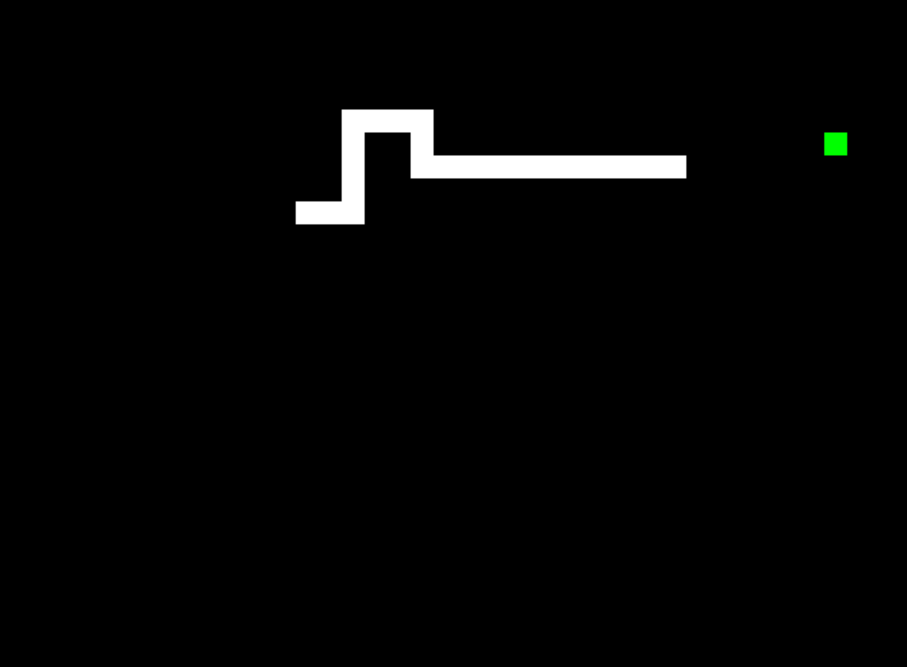
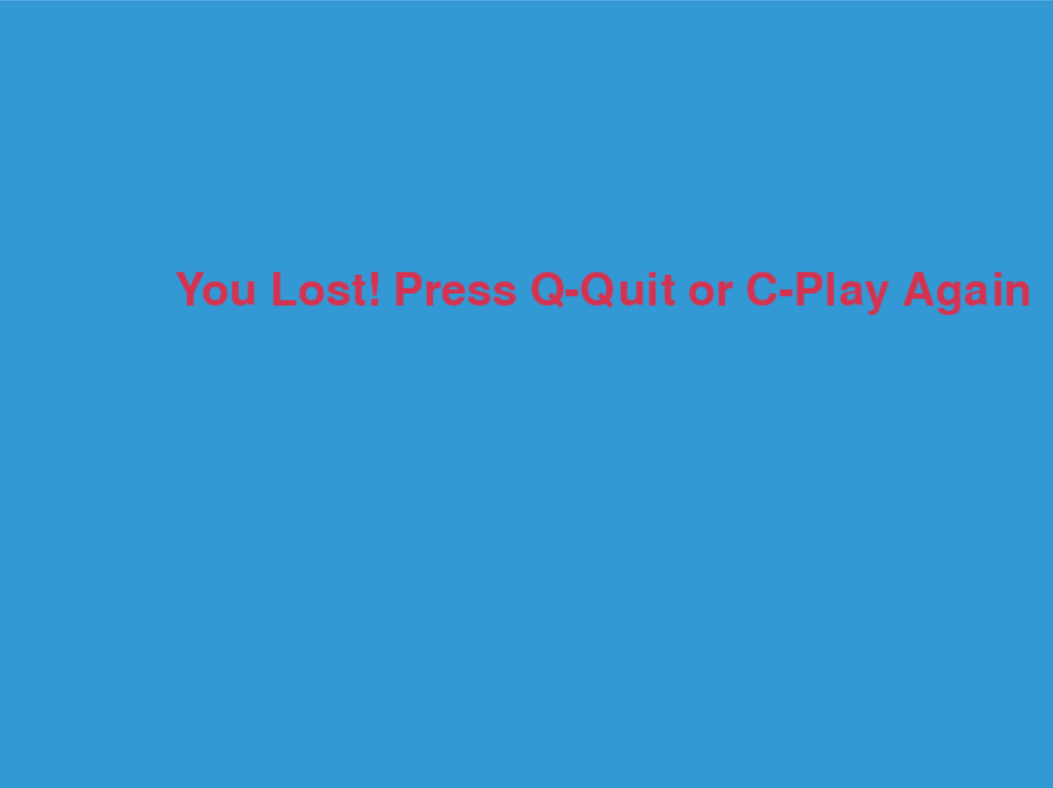
OUTPUT

Slide 11

Results and Discussion
Functional Game
Modern Design Principles
Efficient Implementation
The project successfully delivered a functional and engaging GUI-based Snake game that met the defined objectives.
The results demonstrate the benefits of utilizing modern design principles in game development.
The efficient implementation strategies used in the project contributed to its success.

Slide 12
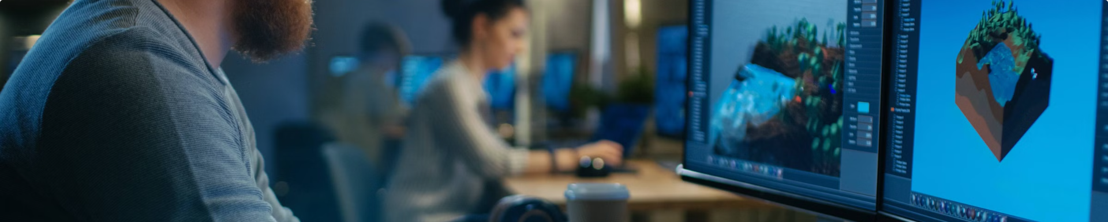
Conclusion
GUI-Based Snake Game
Modern Design Principles
Programming Techniques
The project showcased the development of a GUI-based Snake game.
Demonstrated the effectiveness of using modern design principles.
Highlighted the importance of advanced programming techniques in game development.

Slide 13

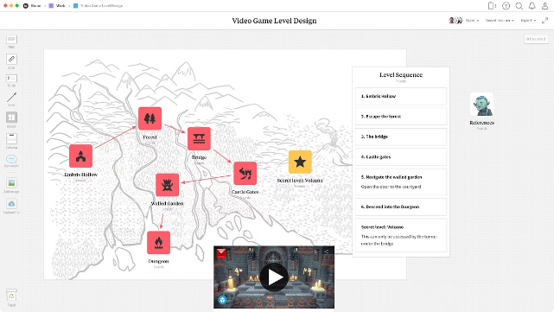
Future Enhancements
Additional Game Modes
Potential enhancement to introduce new game modes for added variety.
More Levels
Consider expanding the game with additional levels to challenge players.
Challenges
Incorporate new challenges to keep users engaged and excited.

